Slide 1

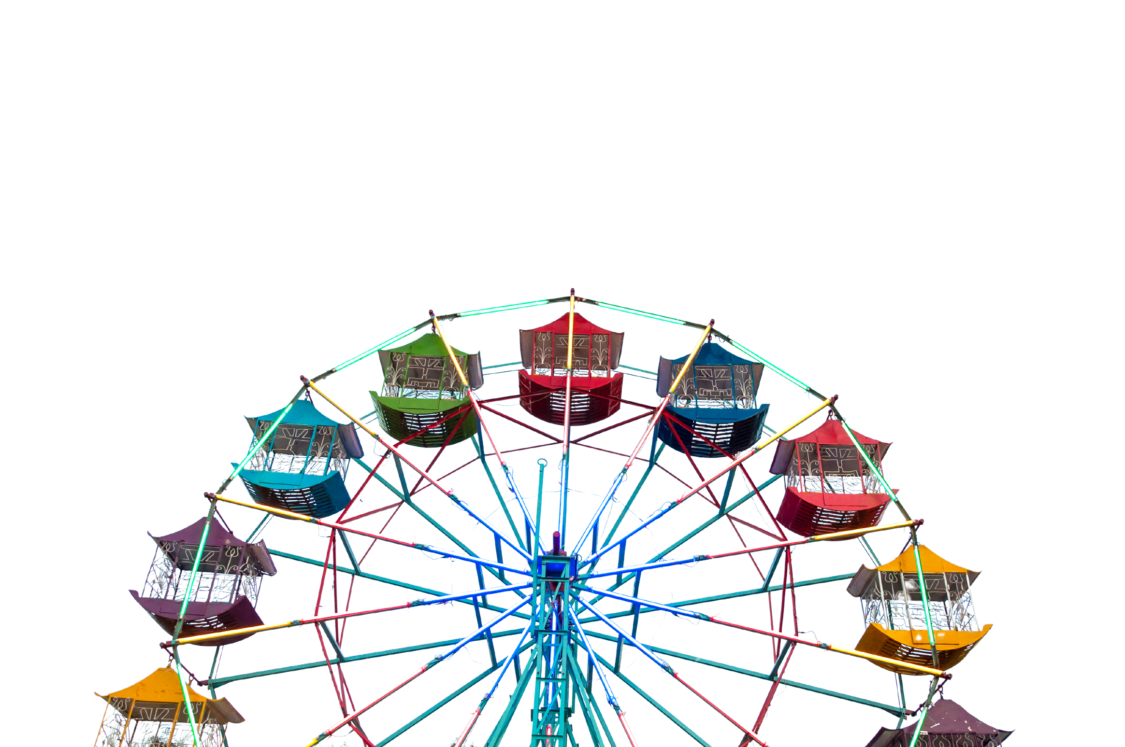


Marketing
Analysis & Strategy
Partnership Strategy of Disney Land with Lobster Land, designed by Prabu Jeyabalan.

Slide 2



SUMMARY
STATISTICS
KEY INSIGHTS
DATASET OVERVIEW
Analyzed 579 Disney movies from 1937–2016, covering genres, revenues, and ratings.
  Genres: Adventure leads in profitability ($24.5B inflation-adjusted gross);
- Comedy is the most frequent with 182
  Ratings: PG-rated films dominate with 187 movies and $1.37B total revenue; G-rated films show exceptional profitability with a $2.9B median inflation-adjusted gross.
Inflation-adjusted gross peaked in 2016 at $28.7B, reflecting Disney’s strategic focus on modern blockbuster franchises like Marvel and also started television streming services
Peak movie releases in the 1990s (236 movies), followed by a shift toward fewer, high-budget Movies post-2000.
Incomplete genre and rating data; skewed inflation adjustments. Adding audience demographics and market trends could enhance analysis.
REVENUE TRENDS
RELEASE TRENDS
DATA LIMITATIONS

Slide 3
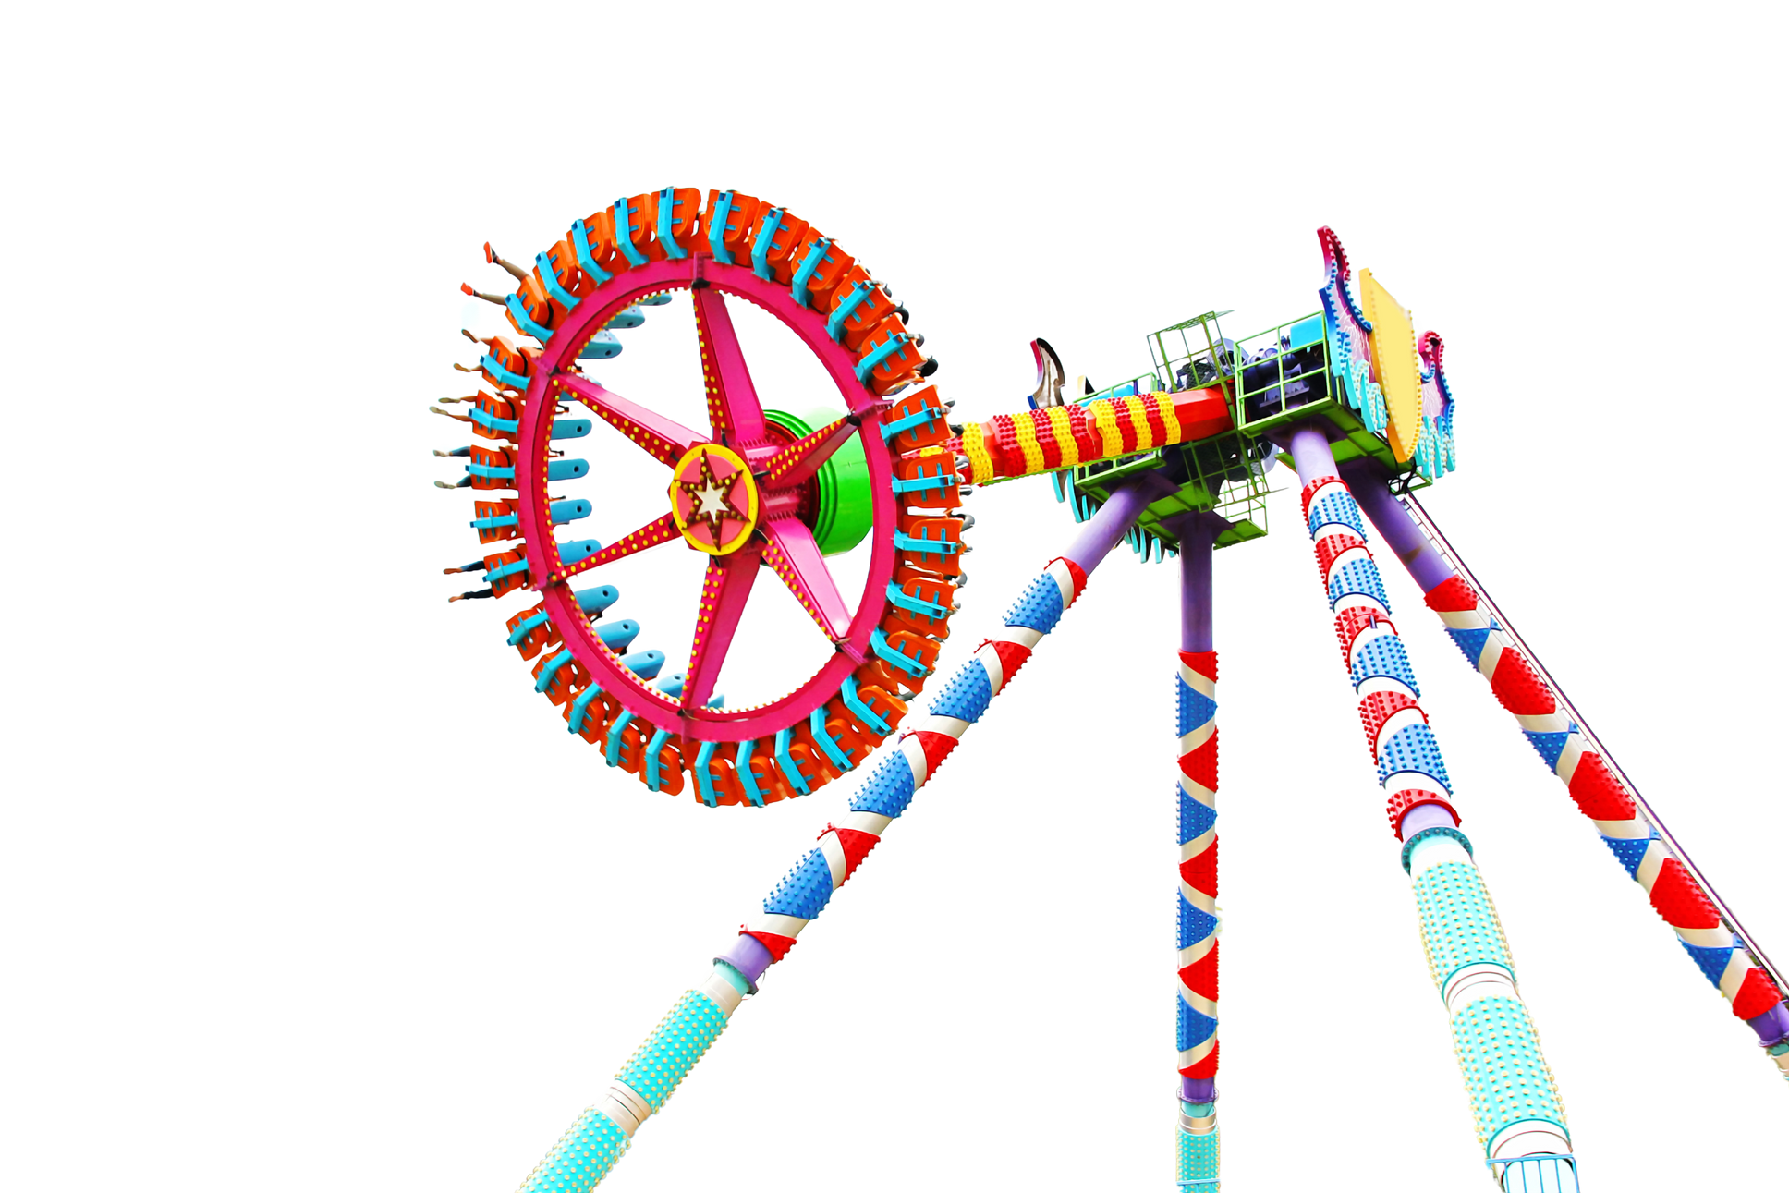
DATA VISUALIZATION

Slide 4
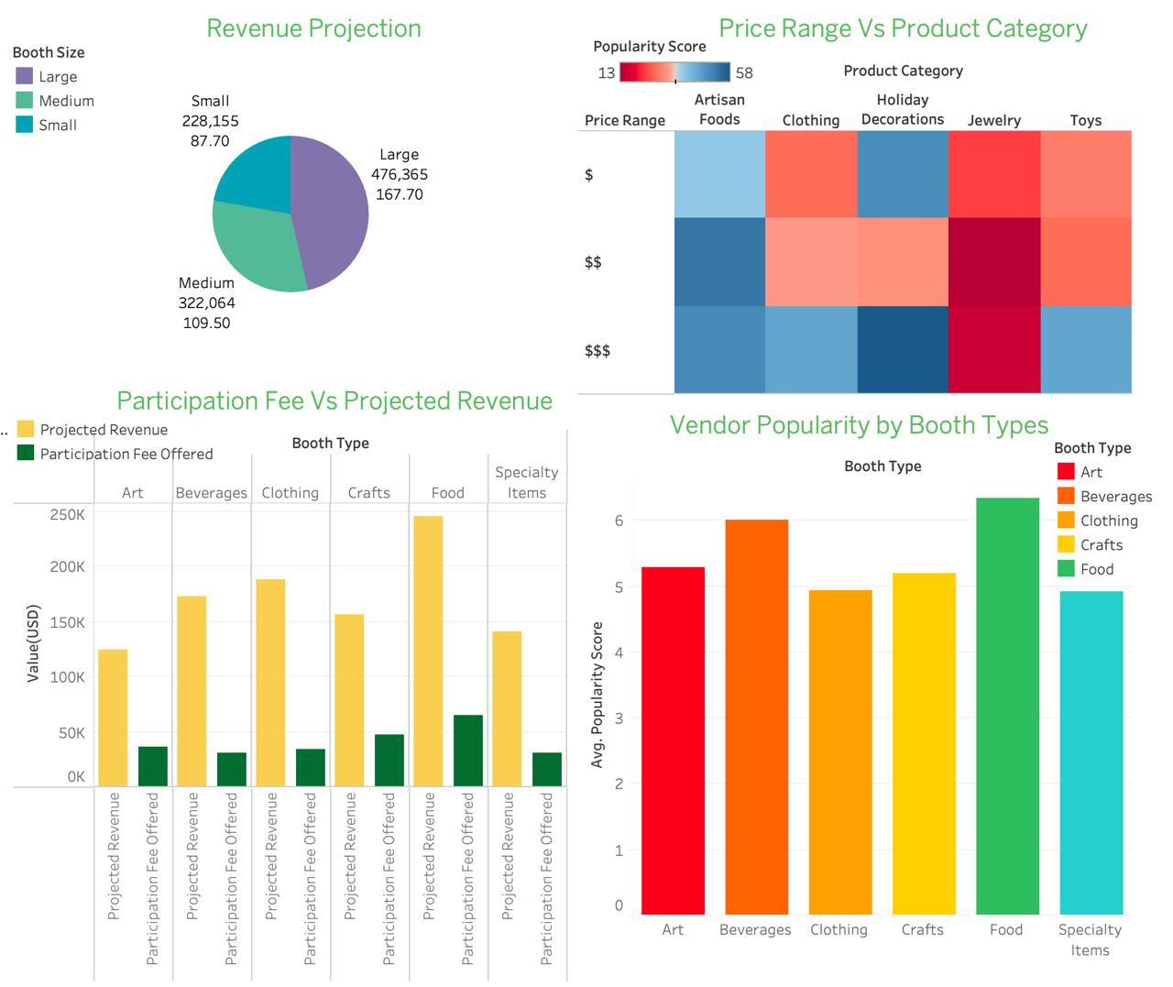
ANGELS MARKET:
DATA VISUALIZATION
Revenue Projection
  Large booths generate the highest revenue ($476,365) but need longer setup time (167.7 minutes).
  Medium booths ($322,064) fit steady traffic areas with balanced setup time.
  Small booths ($228,155) are quick to set up and benefit from reduced fees
  The number of booths to be allocated of each type can be decided.
Price Range vs. Product Category
  Mid-priced Holiday Decorations and Jewelry are highly demanded.
  Artisan Foods perform well across all price ranges.
  High-priced items need added-value strategies to boost Revenue

Slide 5

ANGELS MARKET:
DATA VISUALIZATION
Participation Fee vs. Projected Revenue
  Food booths have the highest revenue potential(250K); Food stalls can be prioritized according to revenue.
  Art and Crafts booths thrive with visibility and live demos.
  Clothing and Specialty booths need promotions and partnerships.
Vendor Popularity by Booth Types
  Food and Beverage booths are the most popular; place them in high-traffic areas.
  Art and Crafts booths are next popular booths with 5.5 score.
  Combine Specialty Items and Clothing with popular stores to boost traffic and sales.

Slide 6
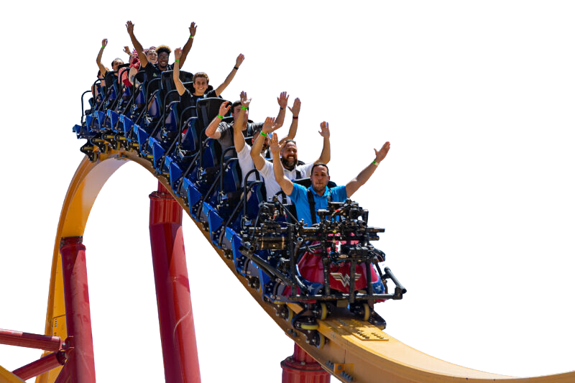
SEGMENTATION &
TAREGTING
It’s
Four
Clusters!
K MEANS CLUSTERING MODEL
Elbow Chart
It Is..

Slide 7
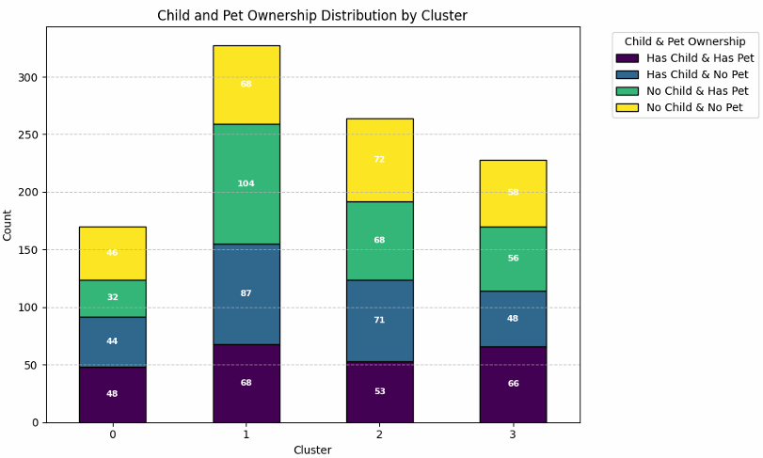
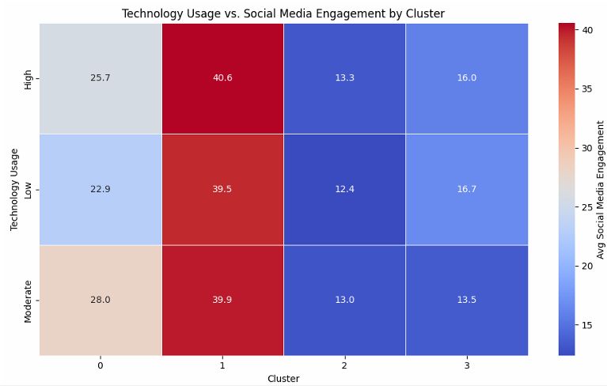
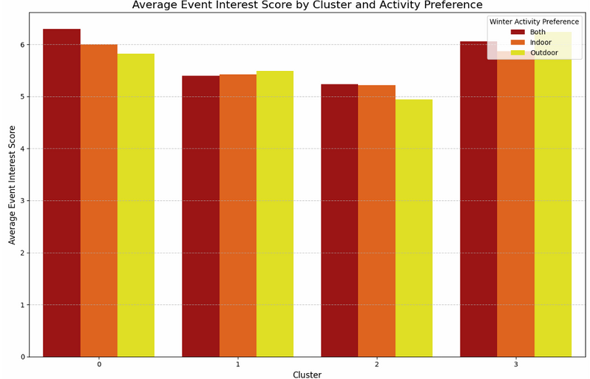
CHILD & PET OWNERSHIP DISTRIBUTION
  Cluster 1 has the highest proportion of childless households (both with and without pets)
  Cluster 0 shows a strong presence of households with both children and pets
  Cluster 3 primarily consists of childless households with low pet ownership
AVG EVENT SCORE BY ACTIVITY PREFERENCE
  Cluster 0: highest average event interest score, particularly for those who prefer both indoor and outdoor activities.
  Clusters 1 and 2: slightly lower event interest scores, with no significant variation across activity preferences.
  Cluster 3: higher event interest score for outdoor activities compared to indoor or mixed preferences.
TECH USAGE VS SOCIAL MEDIA ENGAGEMENT BY CLUSTER
  Cluster 1: all levels of tech usage, shows significantly higher engagement compared to other clusters.
  Clusters 2 and 3: lowest engmt regardless of their tech usage level.
  Cluster 0: High engagement with moderate tech use

Slide 8
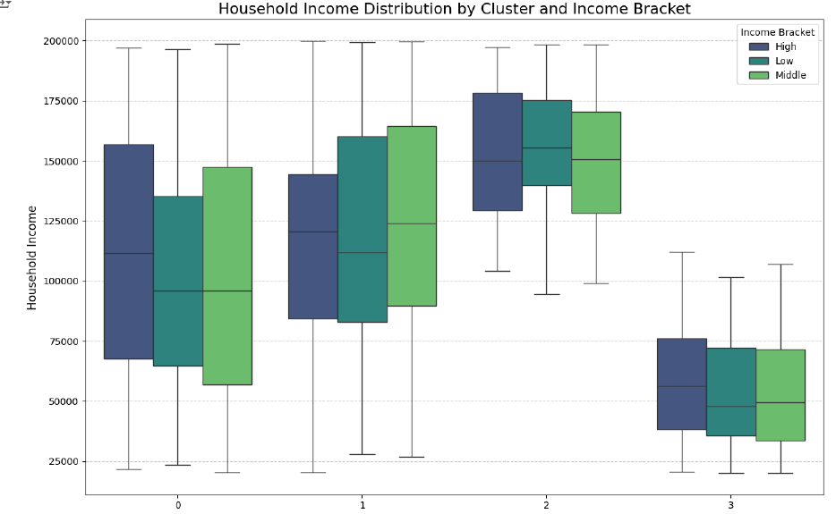
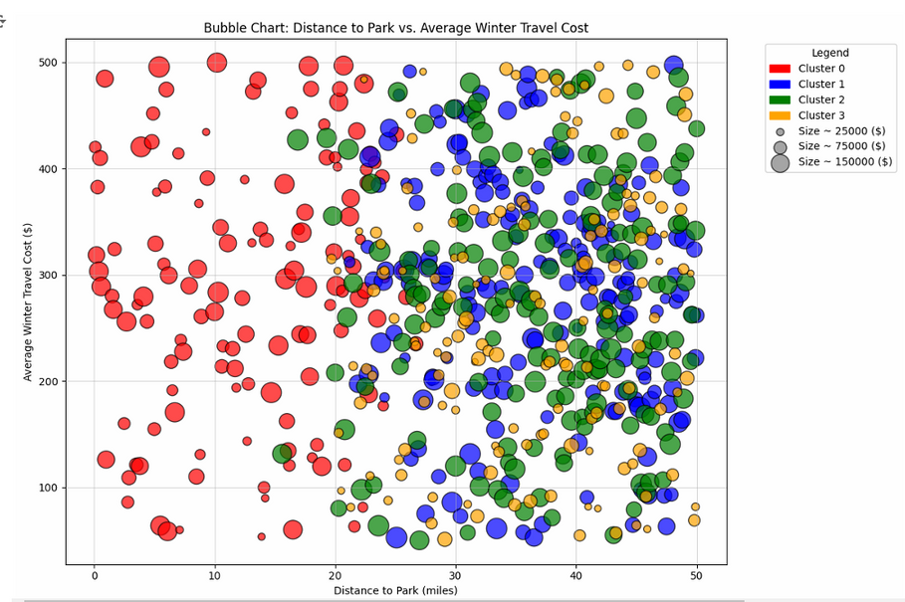
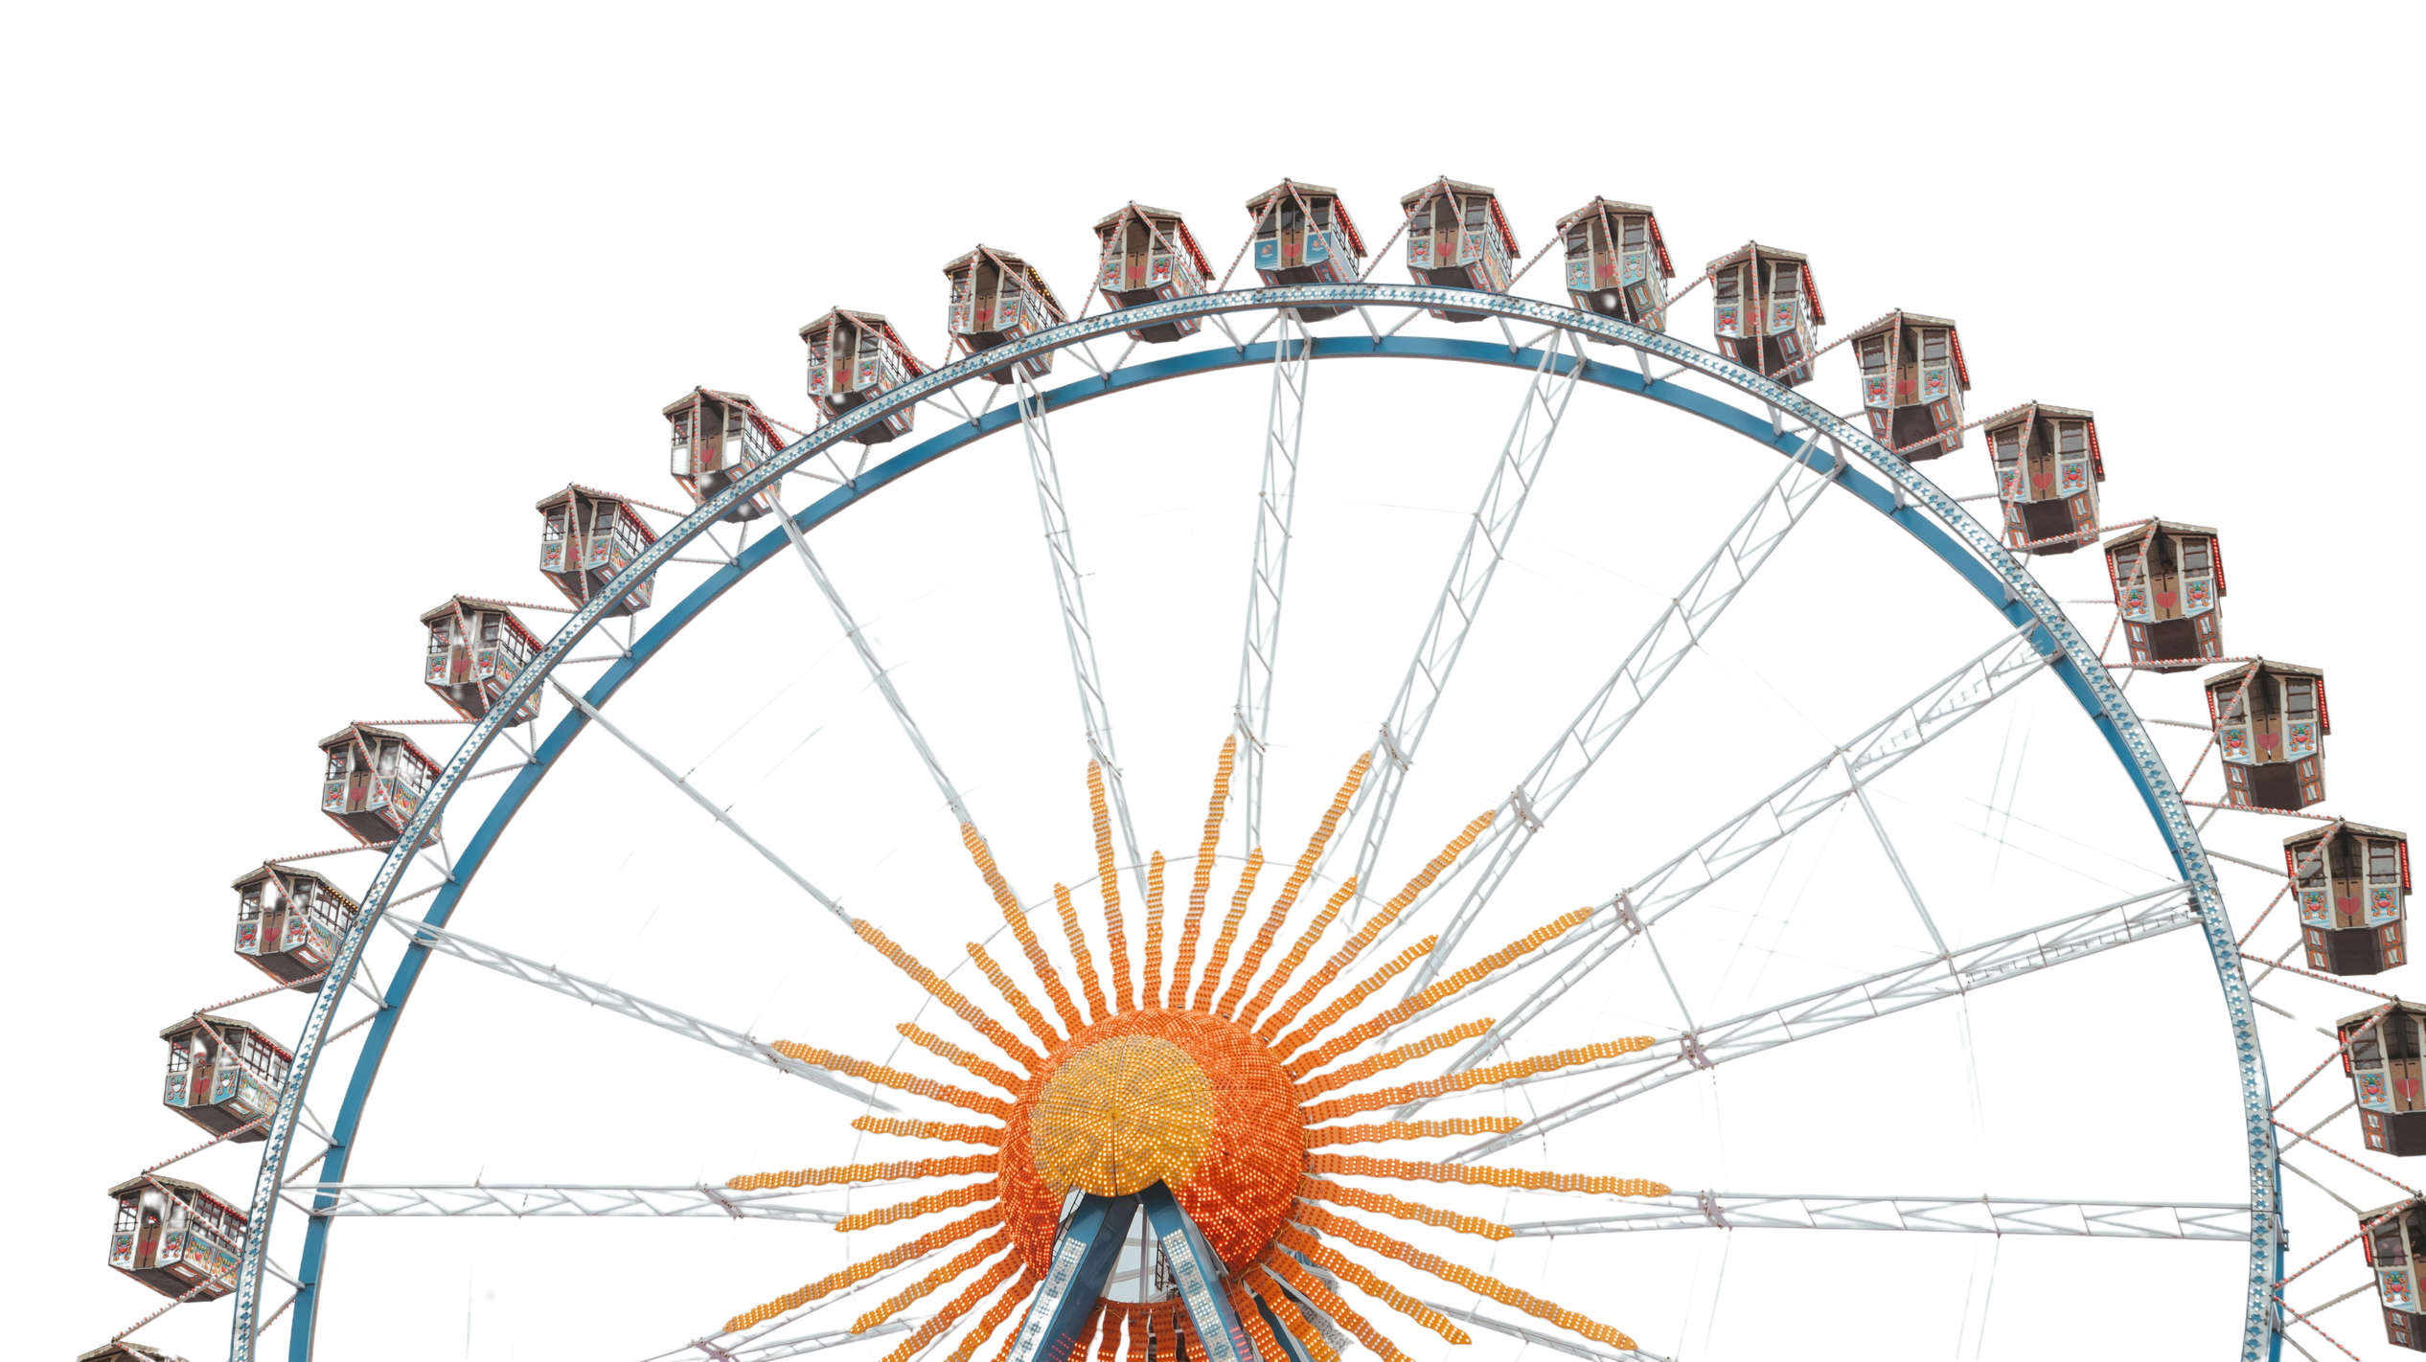

HOUSEHOLD INCOME DISTRIBUTION BY INCOME & CLUSTER
DISTANCE TO PARK VS.
AVG WINTER TRAVEL COST BY HOUSEHOLD INCOME
  Cluster 1 is most economically diverse, with the widest range of household incomes across all brackets.
  Cluster 3 comprises low- and middle-income households, suggesting a less affluent group.
  Cluster 0 and Cluster 2 show moderate income levels, with a noticeable concentration in middle-income brackets.
  Cluster 0 (Red) is closest to the park with high travel costs
  Clusters 1 and 2 (Blue and Green) represent mid-range distances: These clusters have balanced travel costs.
  Cluster 3 (Orange) resides farthest from the park: With the lowest travel costs,

Slide 9
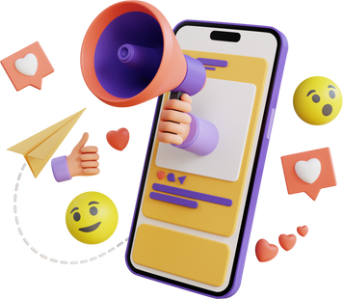

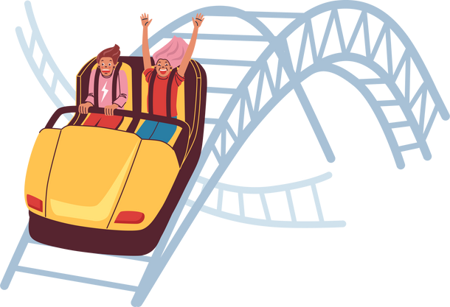


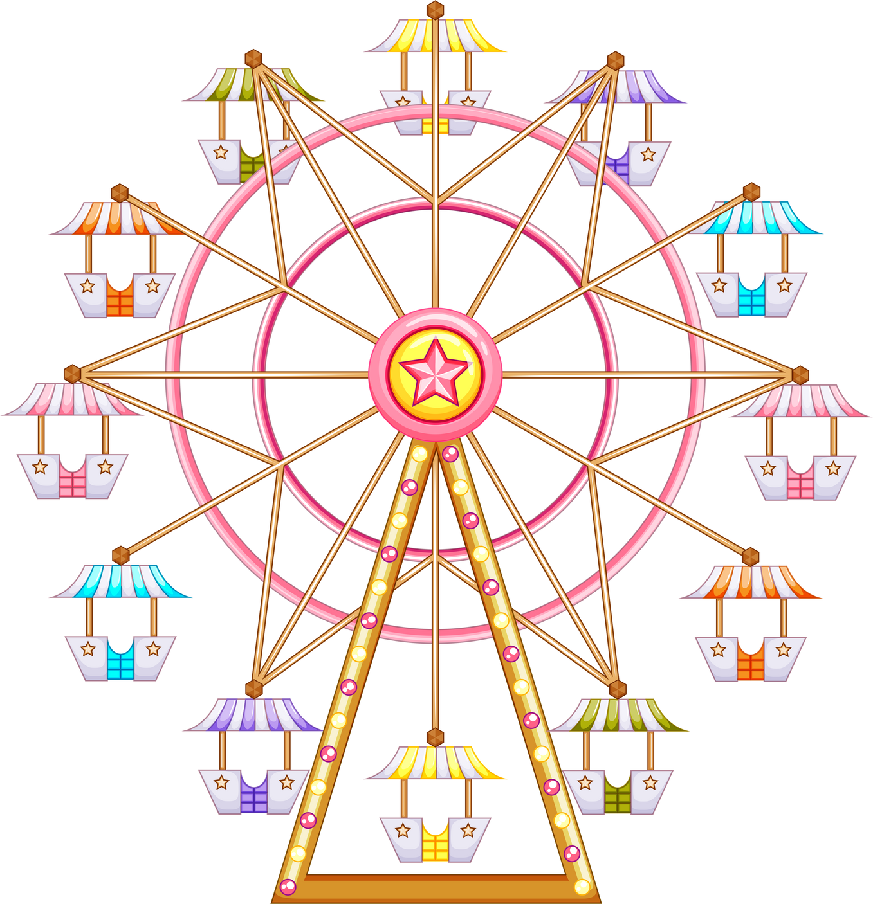


Target Strategy
Target Strategy
interactive campaigns like polls, contests, and giveaways to amplify park awareness.
group discounts, family bundles, or season passes, Designing packages that provide savings on meals, souvenirs, and activities.
Target Strategy
----------------------------------
----------------------------------
Target Strategy
Evening or half-day tickets to accommodate their mid-range distance from the park.
mix of digital and online marketing methods, such as email, posters & collaborations with nearby businesses.
Offering VIP passes
Family Adventure Packages
Providing discounted travel packages, including shuttle services or group transportation
  Most socially active online.
  Moderate distances to Lobster Land
  Diverse household structures
  Mid-range distance from the park,
  Moderate travel costs, and occasional event interest, this
  Characterized by infrequent but meaningful visits
Kid friendly zones, pet friendly zones.
THE SOCIAL SAVVIES
THE OCCASIONAL EXPLORERS
Marketing outdoor experiences such as outdoor rides, parades and events
Promoting winter experiences festive events, themed attractions, and evening light shows
local advertising, Collaborate with travel agencies or community organizations
  Resides closest to Lobster Land
  Spends the most on travel, High household incomes
  Has families and pets
CLUSTERS
  Farthest from Lobster Land
  Low travel costs
  Minimal engagement
  Preference for outdoor activities.
THE PROXIMAL ELITES
THE DISTANT DREAMERS

Slide 10
RECOMMENDATIONS FOR ARUNDELLE BALL:
CONJOINT ANALYSIS INSIGHTS
Linear Regression
Significance of Coefficients:
  Coefficients indicate how each option influences guest satisfaction, based on customer average ratings.
  Higher coefficients represent options that positively enhance the experience, while negative coefficients highlight options with potentially adverse impacts.
  Linear regression enables prioritization by quantifying the relative importance of options, ensuring strategic and data-driven decision-making.
Intercept as Base Cost:
Optimization
Linear regression revealed an intercept of $7.48, representing the base cost per attendee.
OPTIMIZATION approach ensures that maximum customer experience is derived directly from the data without subjective interference.

Slide 11
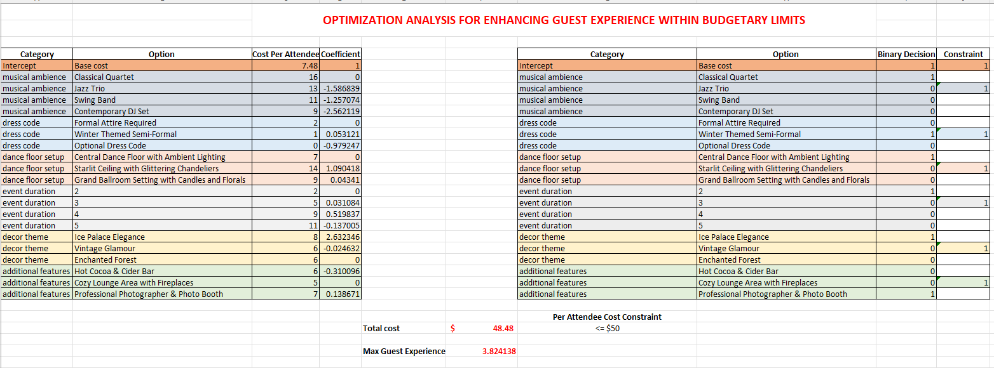
OPTIMIZATION
TO ENHANCE GUEST EXPERIENCE
BASE COST:
The intercept of $7.48 represents the base cost and is a compulsory selection in the model.
BUDGET CONSTRAINT:
Total cost per attendee is capped at $50 to ensure affordability.
SELECTED OPTIONS
  Musical Ambiance: Classical Quartet ($16.00)
  Dress Code: Winter Themed Semi-Formal ($1.00)
  Dance Floor Setup: Central Dance Floor with Ambient Lighting ($7.00)
  Event Duration: 2 hours ($2.00)
  Decor Theme: Ice Palace Elegance ($8.00)
  Additional Features: Professional Photographer & Photo Booth ($7.00)
OBJECTIVE
Maximize guest experience by selecting the optimal combination of event features.

Slide 12

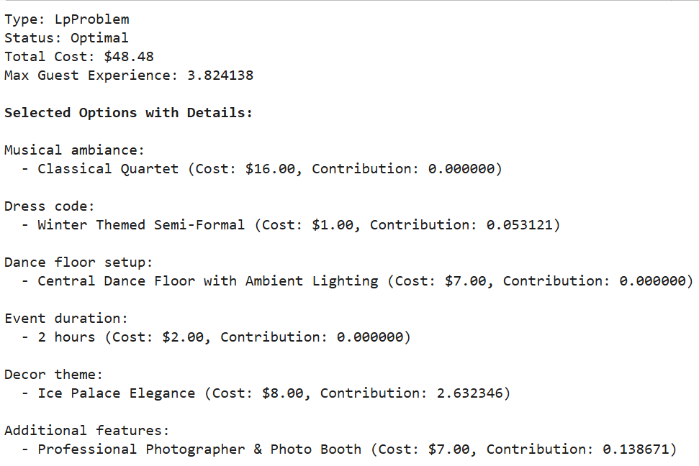
OPTIMIZATION
USING THE SIMPLEX LP METHOD IN PYTHON
CUSTOMER EXPERIENCE
Customer experience is based on average ratings provided by attendees, ensuring an objective measure of satisfaction.
AVOIDING BIAS
Avoiding bias allows the optimization to focus purely on customer feedback, enhancing the accuracy of results.
OPTIMIZATION
OPTIMIZATION approach ensures that maximum customer experience is derived directly from the data without subjective interference.

Slide 13
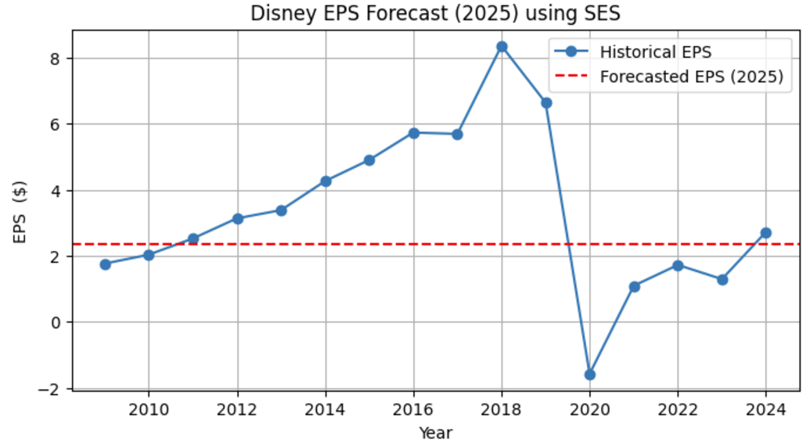
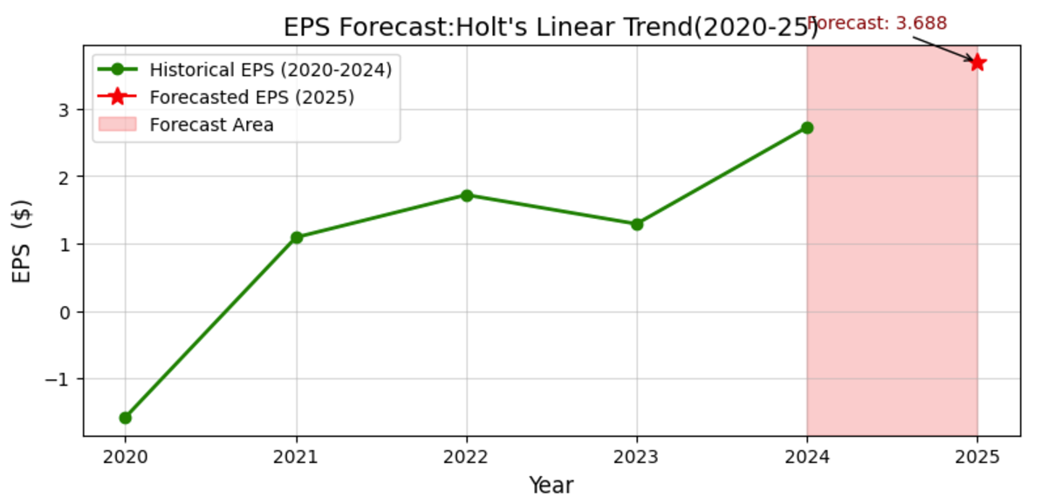
FORECASTING EPS FOR DISNEY
Forecasted EPS for 2025 using SES: $2.36
Forecasted EPS for 2025 using Holt's Linear Trend: $3.69
  Trend Alignment
  COVID-19 Impact Handling
  Improved Forecast Accuracy
  Relevance and Interpretability

Slide 14
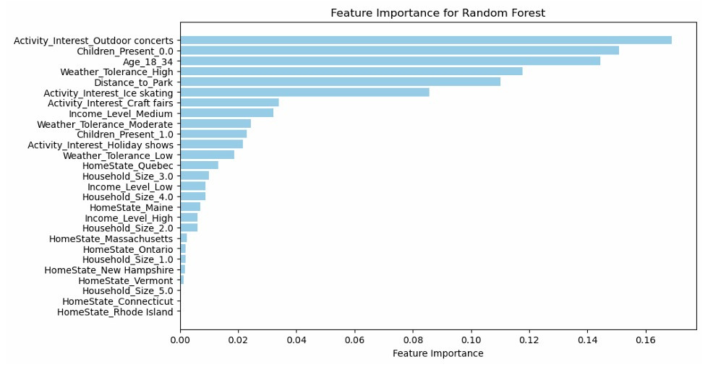
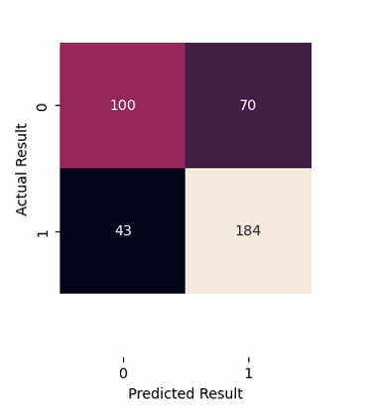
CLASSIFICATION
INDOOR OR OUTDOOR?
Model Used :
Random Forest!!!
ACCURACY
Random Forest Model
Accuracy: 72%
PREFERRED ACTIVITIES
Indoor = 437
Outdoor= 554
LOCATION
35 % From Maine
(Home State for
Lobster Land)
HOUSEHOLDERS:
NO CHILDREN
0 - Indoor
1- Outdoor
  Outdoor Concerts
  No Children
  Age 18-34 Proportion
Most Impactful
60% Indoor
77% Outdoor

Slide 15
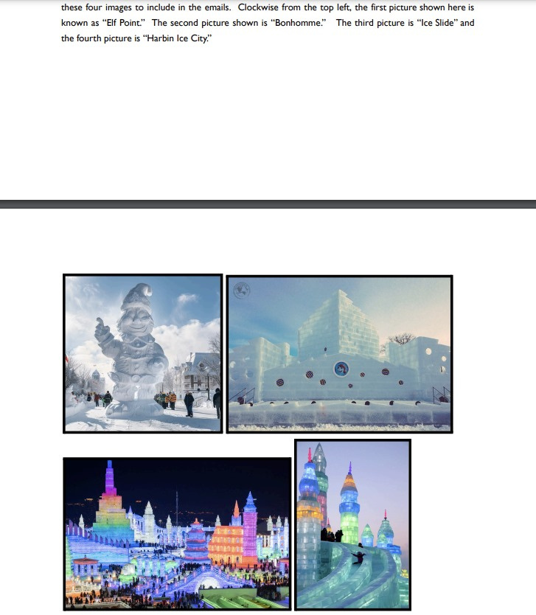
A/B TEST
BEST PHOTO FOR THE 2024 ENCHANTED WINTER CARNIVAL MARKETING CAMPAIGN
Elf Point
Bonhomme
Ice Slide
Harbin Ice City
Key Metrics:
Engagement Time
Photo Rating
Impact (Rating per Second)
Conversion Rate

Slide 16
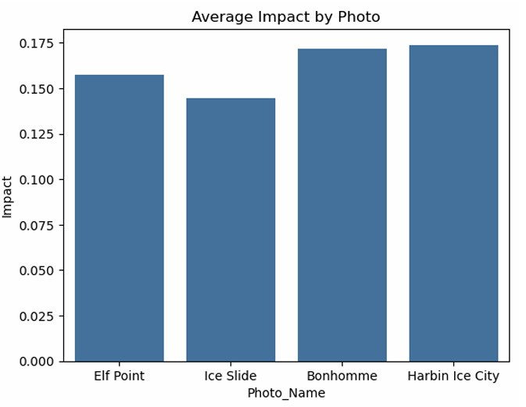
IMPACT
(RATING PER SECOND)
“Ice Slide” - the lowest
Significant differences between some photos, like “Ice Slide” vs. “Bonhomme”
Slowest Performance
“Impact” is not the sole determinant
Other metrics guide the final decision.

Slide 17

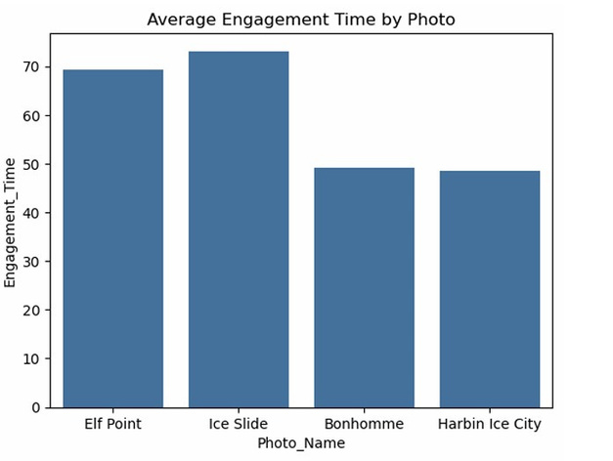
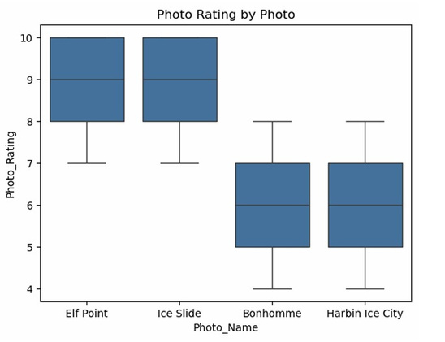
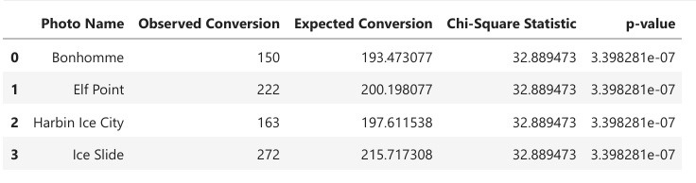
THE THREE MIGHTY
METRICS
Ice Slide- Our Choice
Choice of the photo is important
Significant differences in conversion rates
Rating between 8 and 10
> 70 sec
Longest Time + Positive Feedback
Ice Slide - the best preformance
Increasing recipients action

Slide 18

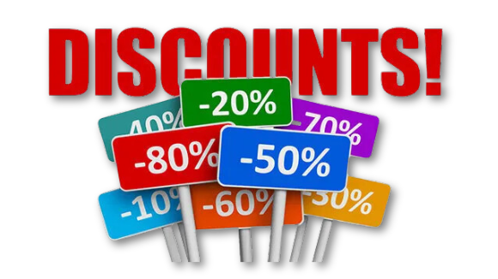
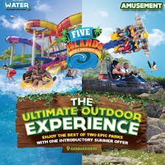
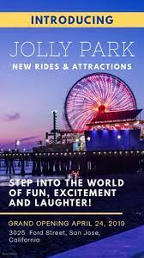
STRATEGY BLUEPRINT
Event Planning:
Live telecasts, social media buzz, and customer-preferred themes.
Branding:
Highlight family, sustainability, and Maine’s heritage.
Innovation:
Interactive ice mazes, AR, and surprise Disney shows.
Partnerships:
Co-branded Disney attractions and global promotions.
Revenue:
Tiered tickets, workshops, merchandise, and vendor partnerships.
Community Engagement:
Collaborate with locals, offer discounts, and host pre-events.

Slide 19
ROADMAP TO TRIUMPH
Data Analysis
Marketing Strategy
Continuous Improvement
Analyze visitor data to uncover key insights.
Select high-performing visuals, like the “Ice Slide,” to boost engagement.
Adapt by enhancing indoor activities, targeting high-potential markets, and creating family-friendly experiences.
Event Planning
Operational Optimization
ACHIEVING SUCCESS !!!
Organize magical, budget-friendly events like the Arundelle Ball with thoughtful options
Strategically place booths to maximize revenue at the Winter Carnival.

Slide 20
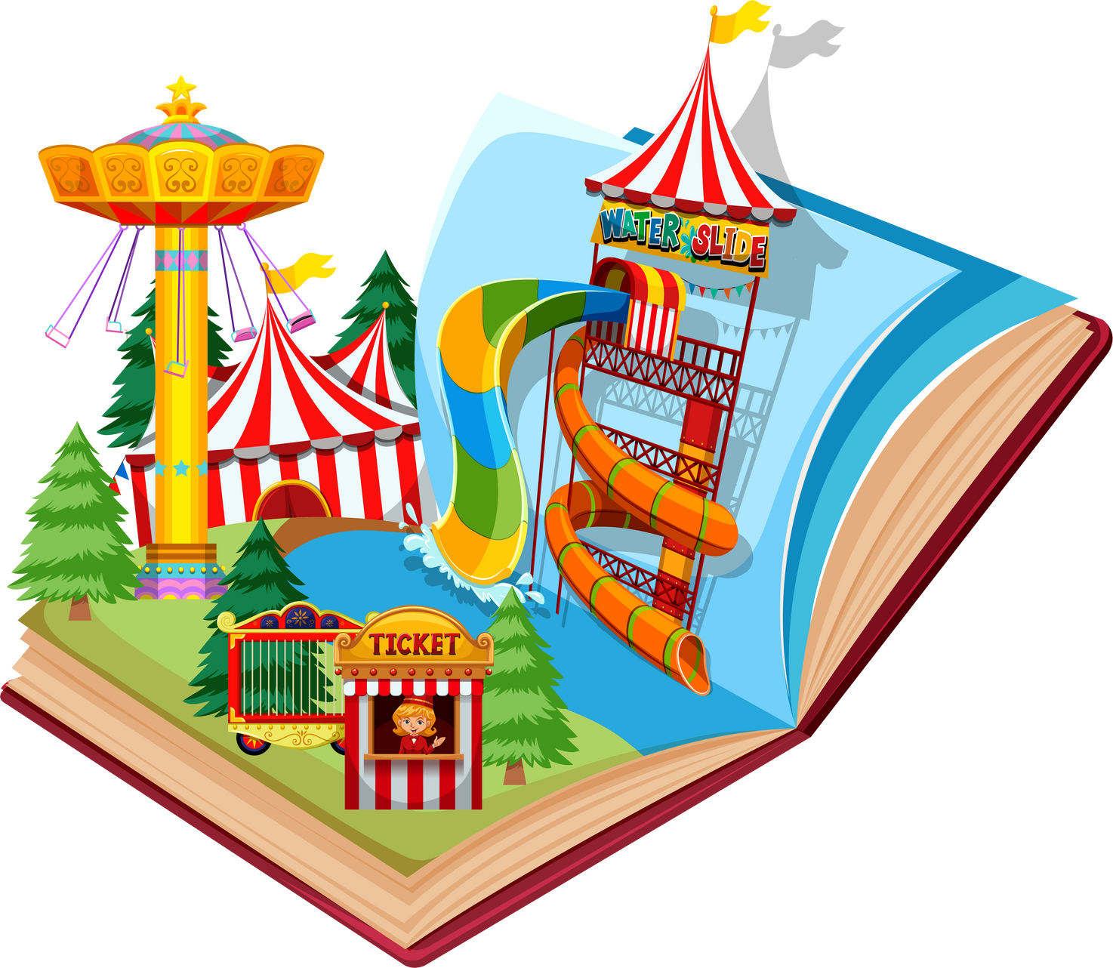

THANK
YOU!

